Slide 1
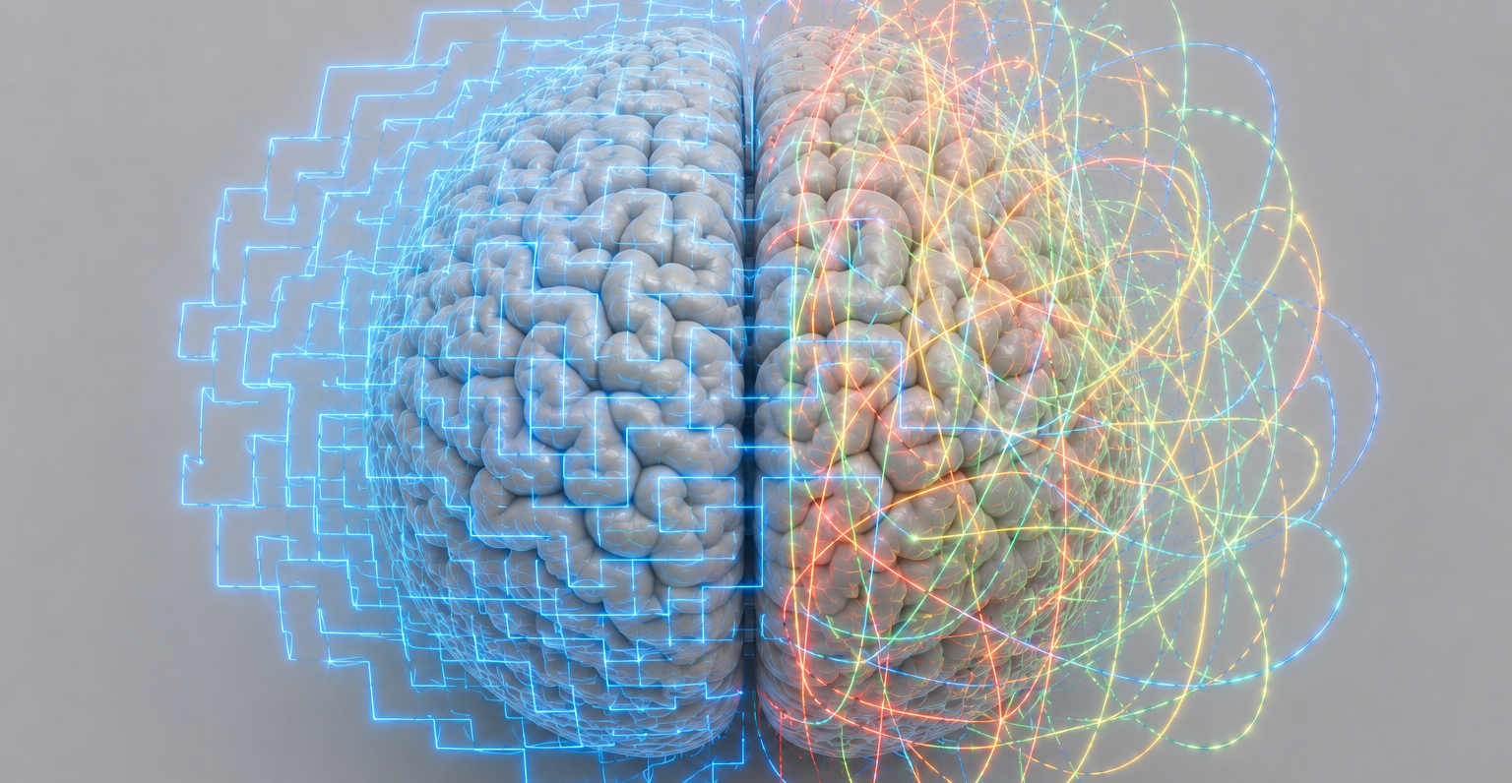


From Multichannel Signals to Brain Networks:
Blind Identification and Tensor Models
Borbála Hunyadi
Associate professor
Signal Processing and AI Research for Clinical NeuroScience (SPARCliN)
Deparment of Neurosurgery & Mental Health and Neuroscience Research Institute, Maastricht University
Signal Processing Systems Group, Delft University of Technology
14.07.2026 | IEEE SAM Workshop
Notes:
Today I'd like to take you on a journey from multichannel signals to brain networks, and show how blind identification and tensor models have helped us answer a number of clinically relevant questions in neuroscience.

Slide 2
Functional neurosurgery
Modulate the nervous system to restore function
Treats chronic conditions:
Movement disorders | epilepsy | severe psychiatric disorders
Targets faulty neural circuits :
Removal | disconnection | stimulation
Relies on advanced imaging for target definition
© Maastricht UMC+
Notes:
Before we start, you may be wondering what a signal processing engineer is doing in a department of neurosurgery.
Our department specializes in functional neurosurgery. Unlike traditional neurosurgery, where the goal is to remove a tumor or repair damaged tissue, functional neurosurgery aims to restore function by modulating the nervous system.
It is used to treat conditions such as movement disorders, epilepsy, and severe psychiatric disorders.
Although these diseases are very different clinically, they have one thing in common: they are associated with malfunctioning neural circuits.
The treatment therefore targets those circuits, either by removing them, disconnecting them, or modulating their activity through electrical stimulation.
This immediately raises a fundamental question:
Where exactly is the faulty circuit?
And answering that question relies heavily on advanced medical imaging.

Slide 3
Epilepsy surgery
PRESURGICAL EVALUATION
DRUG-RESISTANT EPILEPSY
Epileptogenic zone
Hypothetical!
Modern interpretation: network disorder
disconnect the key network nodes from the rest of the brain
FOCAL EPILEPSY
Notes:
Let me illustrate this with epilepsy surgery.
Around thirty percent of epilepsy patients continue to have seizures despite medication. These patients are considered drug resistant.
If the epilepsy is focal—that is, if the seizures originate from one localized brain circuit—surgery becomes a potential treatment option.
The goal of the presurgical evaluation is to identify the epileptogenic zone: the region that needs to be removed or disconnected so that seizures can no longer occur.
Now, there is an important complication.
The epileptogenic zone is a hypothetical construct. There is no imaging modality that directly shows it.
Instead, clinicians combine information from many different measurements, each providing an indirect view of the underlying pathology.
And today, our understanding has evolved even further.
Rather than viewing epilepsy as a single abnormal location, we increasingly consider it a network disorder.
The objective is therefore no longer simply to remove one spot, but to identify the key nodes of the pathological network and disconnect them from the rest of the brain.

Slide 4
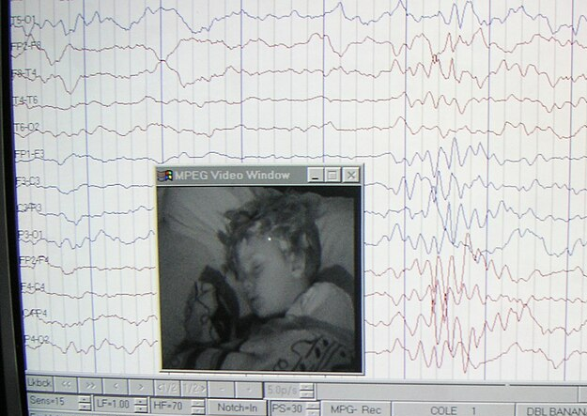
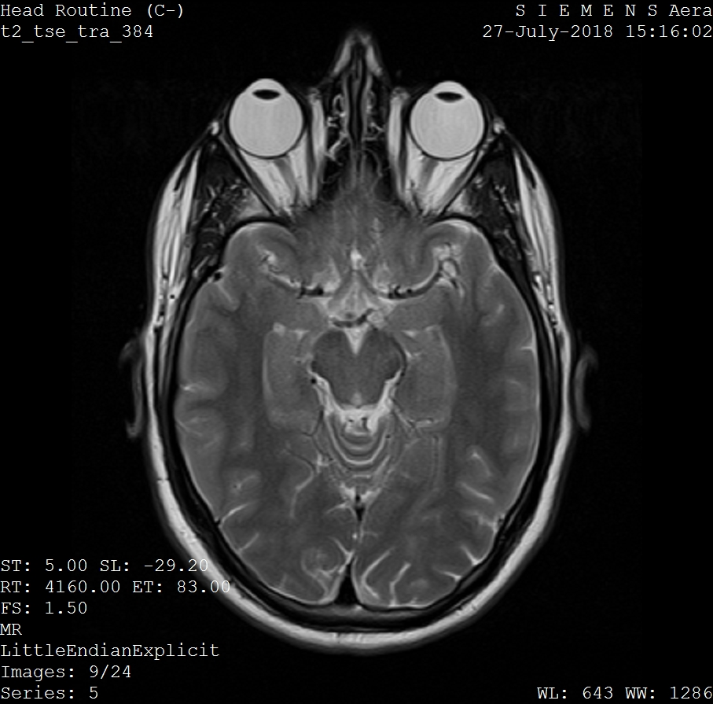
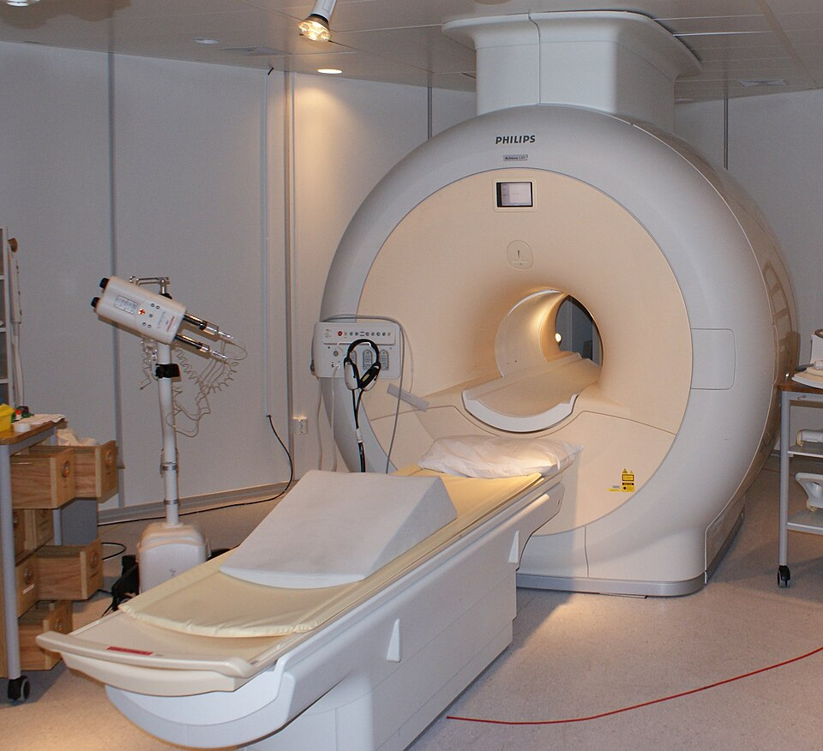
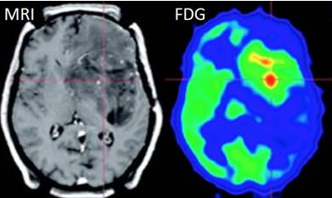
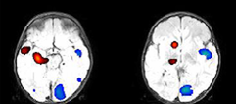
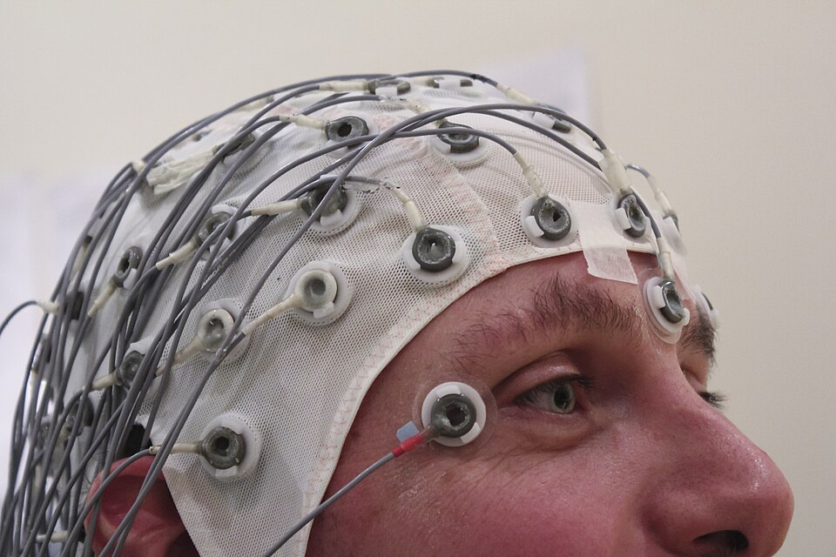
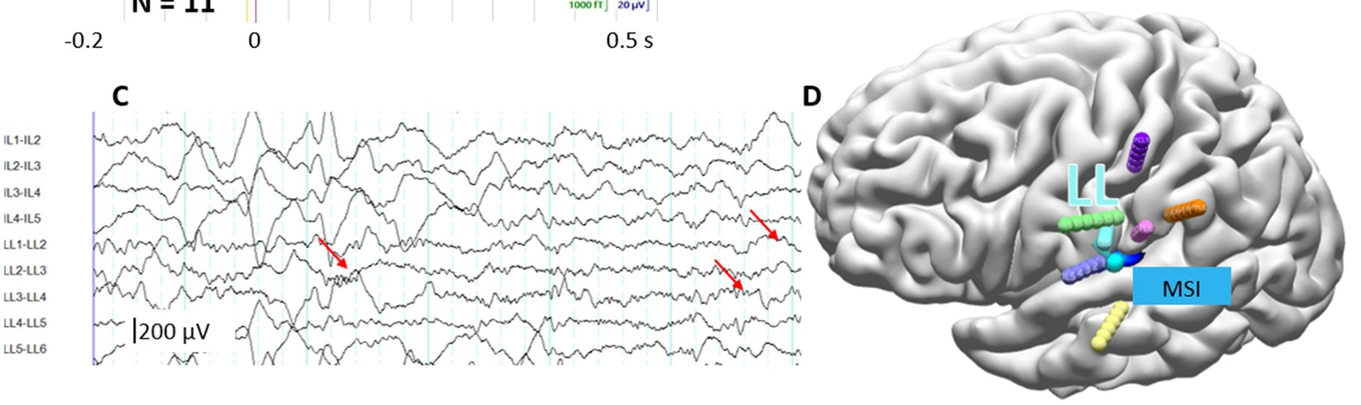
Presurgical evaluation and multimodal imaging
PHASE I
Video-EEG
Structural MRI
EEG-fMRI
PET scan
SPECT scan
INVASIVE EEG
(SEEG)
How to find the key areas from the imaging data?
PHASE II
Notes:
How do we identify those key nodes?
The presurgical evaluation consists of two phases.
The first phase is entirely non-invasive.
Every patient undergoes long-term video EEG and structural MRI. If those do not provide sufficient information, additional modalities such as EEG-fMRI, PET, or SPECT may be acquired.
These are powerful techniques, but they are expensive, technically demanding, and not always available.
Much of my own research focuses on EEG-fMRI, because I believe advanced signal processing can substantially improve the information we obtain from these measurements.
Ideally, we would like to extract so much information from the non-invasive data that we can reduce the need for the second phase.
That second phase involves implanting electrodes directly into the brain, which is invasive and carries risks.
So ultimately, the question becomes:
How can we identify the critical brain areas from imaging data alone?

Slide 5
The signal processing challenge
Large observations
Mixture of sources
EEG: 100 x 10⁷ (24 hrs)
fMRI: 10⁵ x 1000 (20 min)
Activity of interest
Background brain activity
Physiological artifact
Noise
Different biophysics
Low SNR
Mismatch in references space and resolution
Different temporal dynamics
Indirect measurement
Due to mixing
Activity is sparse in time
and space
Notes:
From a signal processing perspective, this is an exceptionally difficult problem.
Both EEG and fMRI are multichannel signals.
For EEG, the channels are the electrodes and the samples are acquired over time.
For fMRI, you can think of the individual voxels —or brain regions— as channels with their own time course, as every acquired brain volume provides one time sample for all of those channels simultaneously.
So, in both cases, we end up with large multichannel datasets containing measurements from many channels over time.
Second, every measurement is a mixture of many underlying brain processes, physiological artifacts and noise.
Third, EEG and fMRI measure the brain in fundamentally different ways.
They differ in spatial resolution, temporal resolution, and even in the underlying biophysics.
Finally, the signal of interest is extremely difficult to detect.
Not only is it mix with ongoing brain activity, physiological artifacts, and measurement noise, but it is also exceptionally sparse.
In epilepsy, the abnormal activity is present only during a tiny fraction of the recording, and typically involves only a small subset of electrodes or voxels.
So the clinically relevant signal is literally hidden in a vast amount of normal brain activity.
As such, before we can answer a clinical question, we first have to solve a very challenging signal processing problem.

Slide 6
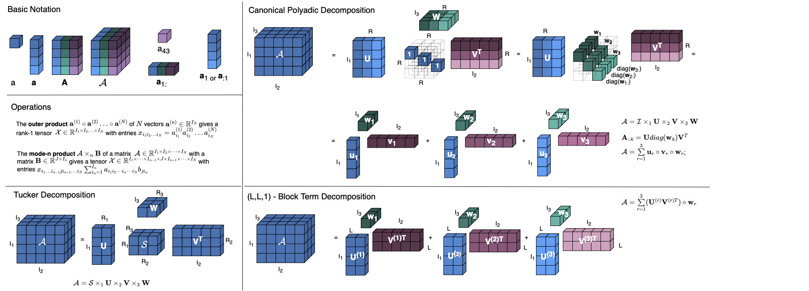

The case for tensor decompositions
Inherent representation of multiway data
Big data represented by few parameters
Multiway structure obscured when unfolding into a matrix
I₁ x I₂ x I₃ >> R₁ x R₂ x R₃ +
I₁ x R₁ + I₂ x R₂ ₊ I₃ x R₃
I₁ x I₂ x I₃ >> R x (I₁ + I₂ + I₃)
Notes:
One way to address the first challenge is to preserve the multiway structure of the data.
Many biomedical datasets are inherently multidimensional.
Take fMRI as an example. Every dataset has three spatial dimensions, and for each voxel we acquire a time series. So inherently, it is a four-dimensional dataset.
Tensor decompositions operate directly on these multiway representations.
Instead of working with millions of individual data points, they approximate a large tensor as a combination of much smaller tensors or factor matrices, resulting in a very compact representation.
An important advantage is that they preserve the underlying multiway structure of the data.
If we first unfold the tensor into a matrix, some of that structural information is obscured before we even start the analysis.
So, tensors provide both an efficient representation and a way to retain the structure that is already present in the data.

Slide 7
The signal processing challenge
Large observations
Mixture of sources
✅
EEG: 100 x 10⁷ (24 hrs)
fMRI: 10⁵ x 1000 (20 min)
Activity of interest
Background brain activity
Physiological artifact
Noise
Different biophysics
Low SNR
Mismatch in references space and resolution
Different temporal dynamics
Indirect measurement
Due to mixing
Activity is sparse in time
and space
Notes:
So this addresses the first challenge: how to handle these extremely large datasets.
But the data are still mixtures of many underlying brain processes.
So the next question is:
How do we separate those latent sources?

Slide 8
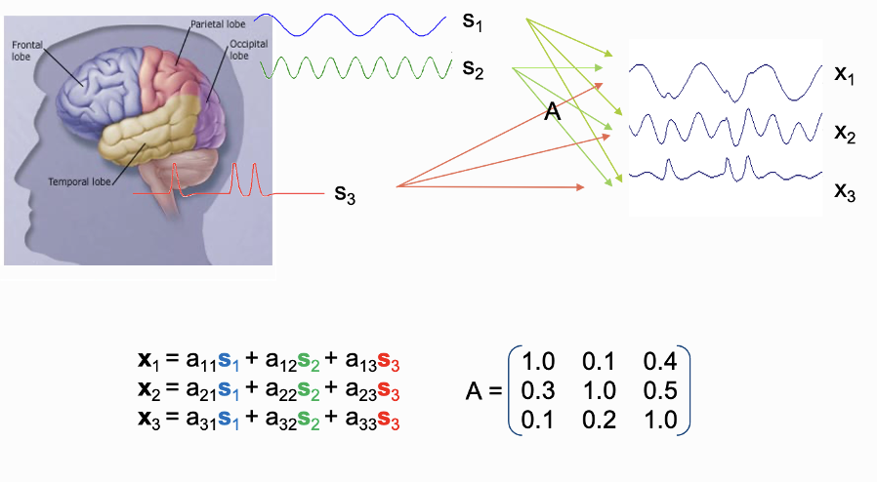
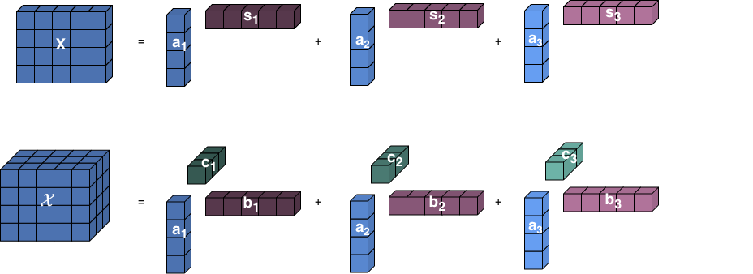
The case for tensor decompositions
Blind source separation (BSS) problem:
Estimate the unknown A and S
based on the observations X
Matrix decompositions are not unique:
Tensor decompositions are unique:
the factors a_{r} , b_{r} , c_{r} are interpretable!
Notes:
As I mentioned earlier, neither EEG nor fMRI measures the underlying neural sources directly.
Instead, each observation is a mixture of multiple underlying brain processes.
The standard blind source separation model assumes that this mixing is linear.
Under that assumption, we can write the observations X as the product of a mixing matrix A and a source matrix S.
The goal of blind source separation is remarkably ambitious.
We observe only X, and from that alone we want to recover both the unknown sources and the unknown mixing process.
The problem, however, is that ordinary matrix factorizations are generally not unique.
There are infinitely many pairs of matrices that reproduce exactly the same observations.
Tensor decompositions fundamentally change this picture.
Under relatively mild conditions, they are unique.
That means the recovered factors correspond to the underlying latent processes and therefore become directly interpretable.

Slide 9
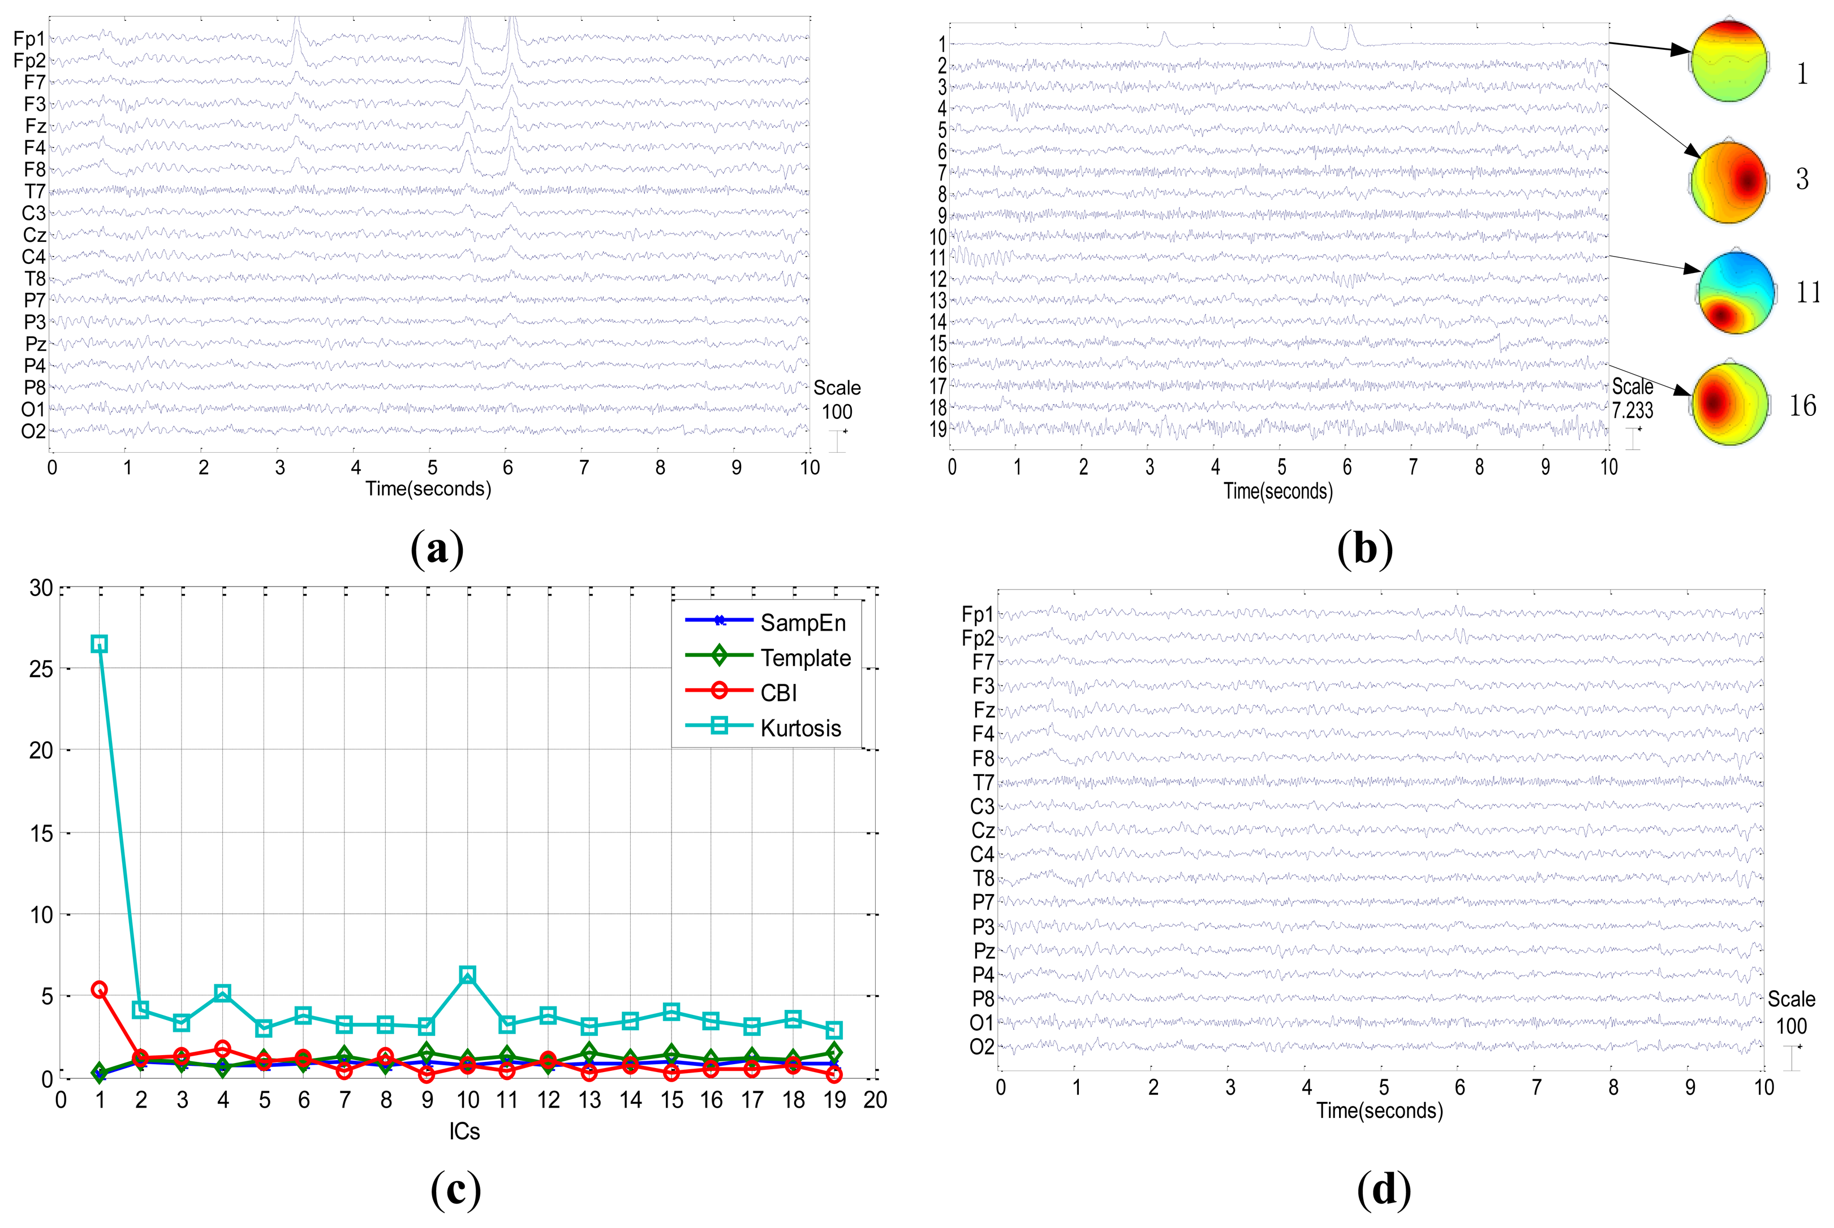
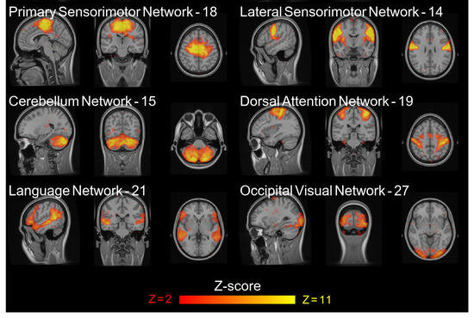
ICA: a good alternative?
Long-standing tradition in EEG:
artifact removal
In fMRI: derive functional networks with
are spatially independent!
( voxels >> time samples )
Notes:
At this point, you may be wondering:
Do we really need tensor decompositions? What about ICA?
After all, ICA has been enormously successful in biomedical signal processing.
In EEG, it has a long-standing tradition.
The idea is to decompose the recordings into temporally independent sources. In practice, this reliably separates artifacts such as eye blinks or muscle activity from the neural signals of interest.
Today, ICA-based artifact removal is part of virtually every standard EEG processing pipeline.
Interestingly, ICA is also extremely popular in fMRI, but it is used in a rather different way.
Because an fMRI dataset contains far more voxels than time samples, the statistical problem is quite different from EEG.
Instead of searching for temporally independent sources, ICA identifies spatially independent patterns of brain activity.
These spatial components often correspond to meaningful functional brain networks, and this has been demonstrated in countless studies.
So ICA has undoubtedly been one of the major success stories of blind source separation in neuroimaging.
The question, then, is not whether ICA works.
The question is whether it is sufficient for the problems we ultimately want to solve.

Slide 10
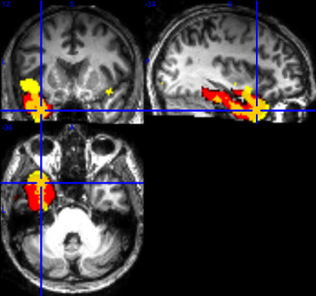
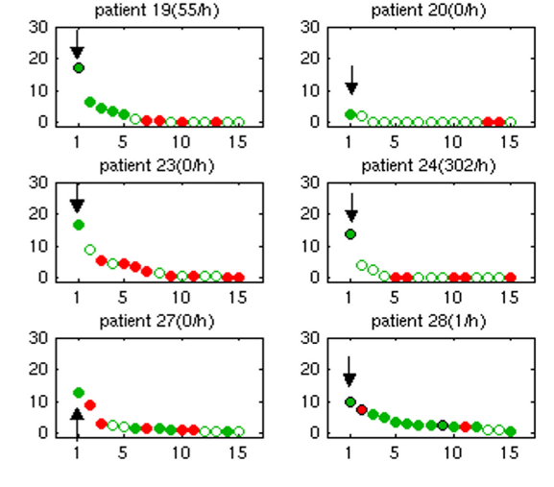
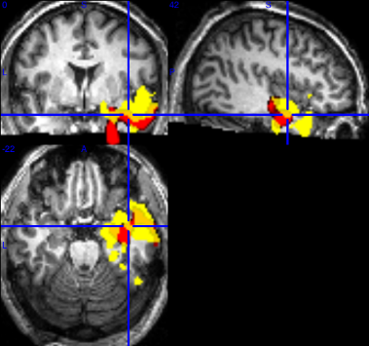
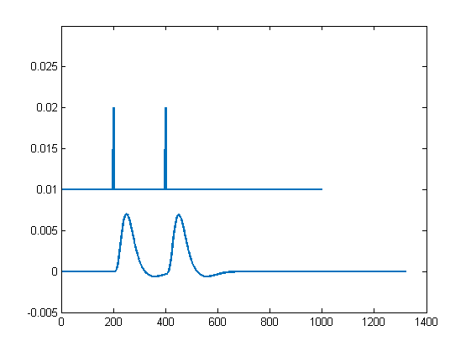
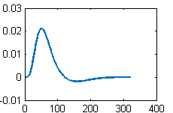
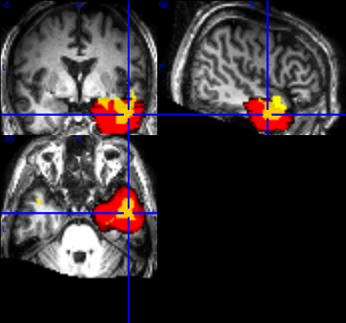
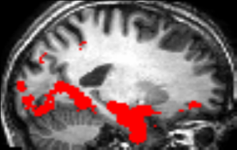
ICA of fMRI in epilepsy
FIX toolbox to remove artifact ICs
Feature engineering
ICA
GLM
SVM classification
EEG-correlated fMRI
What if EEG is not informative?
Concordant spatial maps ✅
Epileptic component selection ⚠️
Possible solution: better inform the decomposition!
Hunyadi et al. (2013). PLOS One | Hunyadi et al.(2015) Neuroimage
Notes:
In my own work, I asked whether ICA could help solve one of the major limitations of EEG-fMRI in epilepsy.
The conventional analysis relies on epileptic discharges that are visible on the EEG. These are used to build a model for analysing the fMRI data.
The problem is that, in many patients, no epileptic activity is visible on the EEG during the scan.
The obvious question is whether the fMRI still contains information about the epileptogenic zone in those patients.
My hypothesis was that it does.
So instead of analysing the fMRI with a model derived from the EEG, I completely ignored the EEG and applied ICA directly to the fMRI data.
The first important finding was that components corresponding to the epileptogenic zone could indeed be identified, even in patients without visible EEG spikes.
The remaining challenge was to determine which of the many ICA components actually represented the epileptic process.
To address this, I developed a machine-learning approach that automatically classified the independent components after removing obvious artifacts with the FIX toolbox.
This substantially improved the clinical applicability, and in many patients the identified spatial maps agreed well with the clinical hypothesis.
However, the approach was still not fully satisfactory.
ICA typically produces thirty to fifty components, while only one or two are actually relevant.
Selecting the correct component therefore remains a difficult classification problem.
This naturally raises the question:
Can we better inform the decomposition itself, so that it extracts fewer—but more meaningful—components from the start?

Slide 11
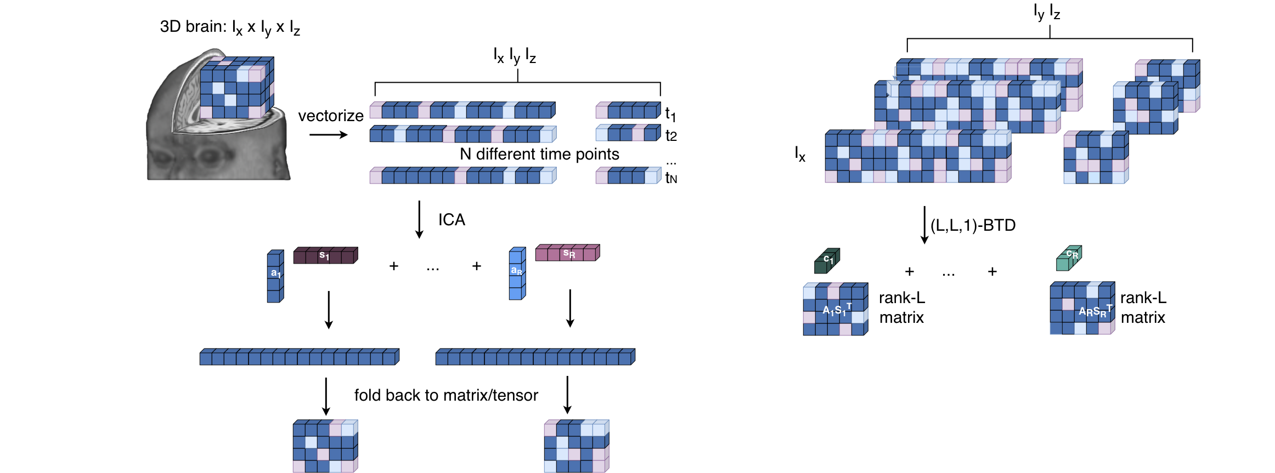
From ICA to BTD of fMRI
Low-rank assumption on acts as a regularizer
Chatzichristos et al. (2019). Journal of neuroscience methods
Notes:
One possible strategy is to better exploit the spatial structure of the fMRI data.
Remember that an fMRI volume is inherently three-dimensional.
ICA begins by vectorizing each volume, effectively flattening the three-dimensional spatial structure into a single long vector.
In doing so, it discards valuable structural information.
Chatzichristos and colleagues proposed a very elegant alternative.
Instead of vectorizing the slices, they keep each slice in its natural matrix form.
Assuming that these matrices have low rank leads naturally to an (L,L,1) Block Term Decomposition: low-rank structure in the two spatial dimensions, and a rank-one temporal signature.
This low-rank assumption acts as a powerful regularizer.
It encourages compact, spatially coherent activation patterns, while suppressing complex high-rank structures that often correspond to imaging artifacts.
As a result, the decomposition becomes more specific to the neural activity of interest and produces substantially fewer irrelevant components.

Slide 12
The signal processing challenge
Large observations ✅
Mixture of sources
✅
EEG: 100 x 10⁷ (24 hrs)
fMRI: 10⁵ x 1000 (20 min)
Activity of interest
Background brain activity
Physiological artifact
Noise
Different biophysics
Low SNR
Mismatch in references space and resolution
Different temporal dynamics
Indirect measurement
Due to mixing
Activity is sparse in time
and space
Notes:
So at this point, we have several tools for tackling the source mixture.
But if we look more carefully, another problem remains.
The temporal signatures extracted by ICA—or by BTD—are not the underlying neural activity. The signals we recover are delayed and blurred versions of the underlying neural activity. This limitation does not arise from the decomposition itself, but it is a limitation of the measurement.
So If we want to estimate the neural activity itself—or ultimately combine EEG and fMRI—we have to properly model the properties ot the measurement
And that brings us to the next challenge.

Slide 13
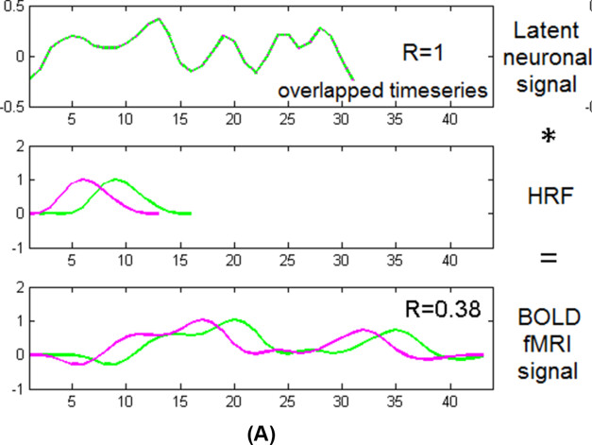
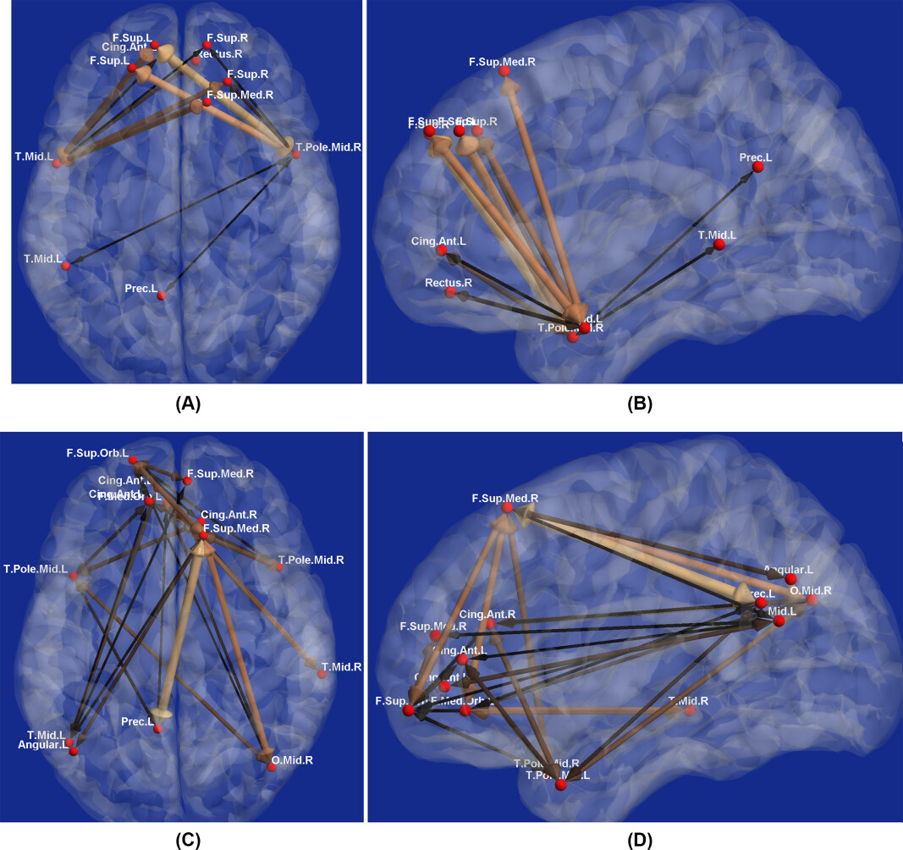
The hemodynamic response function
Variability across cortex
(Siero et al. (2011))
Variability across subjects and days (Handwerker et al. (2004))
THEORY
IMPLICATIONS
Potential false negatives
OBSERVATION
Potential false positives
Handwerker et al. (2004), Siero et al (2011), Deshpande et al (2018)
Notes:
So, what is fMRi measuring exactly, if not neural activity?
When neurons are activated, extra blood flow ensures there is enough oxygen for the tissue. The fMRI measures a contrast in the signal dependent on relative blood oxygen level , i.e. BOLD signal.
From a signal processing perspective, we typically model this as a linear time-invariant system, where the system is described by an impulse response, which we call the hemodynamic response function, or HRF.
The neural activity is convolved with the HRF, producing the fMRI signal that we actually measure.
Many studies for the sake of simplicity, assumed that this system was fixed—that the HRF had exactly the same shape everywhere in the brain and for every subject.
However, this assumption is far too simplistic.
Experimental studies have shown substantial variability across subjects, across brain regions, and even within the same subject on different days.
Why does this matter?
Because if the HRF differs across regions, the measured fMRI signals no longer faithfully reflect the underlying neural activity.
As a result, estimates of functional connectivity can become distorted, leading to both false positive and false negative connections.
So rather than assuming a fixed HRF, we should estimate it from the data together with the underlying neural activity.

Slide 14
From Blind Source Separation to Blind deconvolution
LINEAR MIXTURE CONVOLUTIVE MIXTURE
single obervation, single source
single observation, R sources
M observations, R sources
Blind source separation: Estimate the unknown A and S based on the observations X
Blind deconvolution:
Estimate the unknown h_{mr}(l) and S based on the measured Y
Notes:
This brings us from blind source separation to blind deconvolution. Let's compare the two,
starting with the simplest case: one source and one observation. In a linear mixture the observation is simply a scaled version of the unknown source.
In the convolutive case the single observation generated by a weighted sum of the past values of the unknown source, where the weights are determined by the unknown impulse response.
Now let's make the problem a little more realistic.
The brain contains many simultaneously active neural sources.
So a single observation is already a mixture of multiple (here R) convolved sources. So, instead of a single weight per source, we have a vector of weights per source.
Finally, this is the problem we encounter in fMRI.
Instead of one observation, we now have hundreds of thousands of voxel time series.
Each voxel contains a different mixture of the same underlying neural sources, after convolution with its own hemodynamic response function. So, instead of a single weight per source-observation pair, we have a vector of weights per pair.
So our objective is considerably more ambitious than before.
We want to estimate both the underlying neural activity and the unknown hemodynamic responses directly from the measured data, without observing either of them.

Slide 15
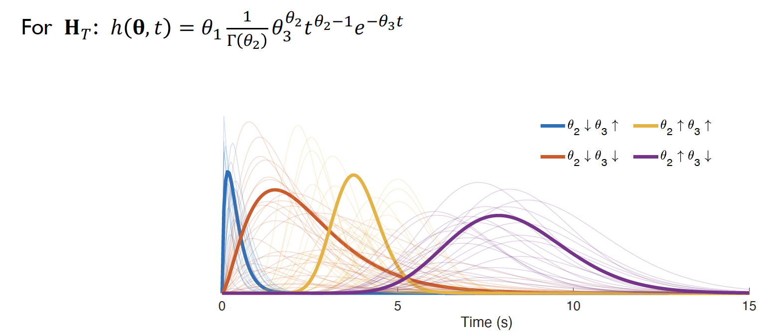
Blind channel estimation
APPLICATION
ASSUMPTIONS and APPROACH
same time course, different HRF across regions
one noise source (non-convolutive)
brain and noise time course are uncorrelated
RESULTS
s₁
s₂
y₁
y₂
y₃
LIMITATION
Does not scale well with the number of observations
Van Eeghem & De Lathauwer 2017, ICASSP | Erol et al. 2023, Neuroinformatics
Notes:
So, how can we actually do this estimation?
To answer this question, we first simplified the problem. We considered a practical example, signals measured during a visual stimulation experiment in mice.
In this experiment, the visual stimulus is processed by three well-known brain regions: the lateral geniculate nucleus, the superior colliculus, and the primary visual cortex.
We therefore assumed that these three regions share the same underlying neural time course, while each region has its own hemodynamic response. we further considered a single noise source to model signals of no interest.
This reduces the number of unknowns considerably.
Assuming that the neural source and the noise source are uncorrelated, the autocorrelation of the sources has a particular block-diagonal structure.
The autocorrelation of the observations is obtained by multiplying, on both sides, the autocorrelation of the sources by a block Hankel matrix constructed from the HRFs. Stacking different delayed versions of this construct in the frontal slices of a tensor naturally gives rise to a Block Term Decomposition.
To further constrain the problem, we incorporated prior physiological knowledge.
Instead of allowing arbitrary temporal filters, we parameterized each hemodynamic response by a gamma function, which is the standard model used to describe the HRF.
This greatly reduces the number of unknowns while ensuring physiologically plausible solutions.
What do we obtain?
The estimated HRFs are physiologically meaningful.
In particular, the cortical response is slower than the response in the subcortical regions, exactly as expected.
Once these HRFs have been estimated, we can deconvolve the measurements to recover the underlying neural activity.
And as you can see on the right, the recovered stimulus timing matches the true stimulation remarkably well—substantially better than the current state-of-the-art method.
Of course, this approach also has its limitations.
The model was developed for only a handful of brain regions.
As the number of observations increases, the size of the tensor grows quadratically, making the approach impractical for whole-brain data.

Slide 16
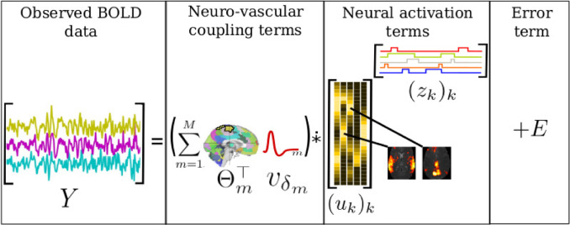
Towards whole-brain deconvolution
Voxel space: mixture of few latent spatial signatures (BSS model)
Each brain parcel has unique, unknown HRF
Voxels are convolved with the parcel-specific HRF
LIMITATIONS
Simplistic HRF model
Vectorization of space
Predefined parcellation
Cherkaoui et al. (2021) NeuroImage
Notes:
So the obvious question becomes:
Can we perform blind deconvolution for the entire brain?
One elegant solution was proposed by Cherkaoui and colleagues.
The key idea is to describe whole-brain activity as a combination of a small number of latent spatial signatures.
The measurements in any given time point are then described as a linear combination of their momentary activity level, the neural activation terms. This is similar to the ICA-fMRI model, without the independence assumption.
Independently of this, every voxel is assigned to a predefined anatomical parcel, and all voxels within the same parcel are assumed to share a common hemodynamic response.
This leads to a very attractive model.
It allows whole-brain deconvolution while keeping the number of unknowns manageable.
However, there are still several important limitations.
First, the hemodynamic response is modeled rather simplistically.
Second, the anatomical parcellation is fixed beforehand, which may not be ideal in neurological disorders where the functional organization of the brain can be altered.
And finally, the three-dimensional brain volumes are again vectorized, so the spatial structure is not fully preserved.
So the question becomes: can we combine the scalability of this model with a more realistic description of the hemodynamic response?

Slide 17
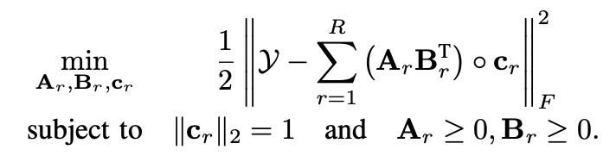
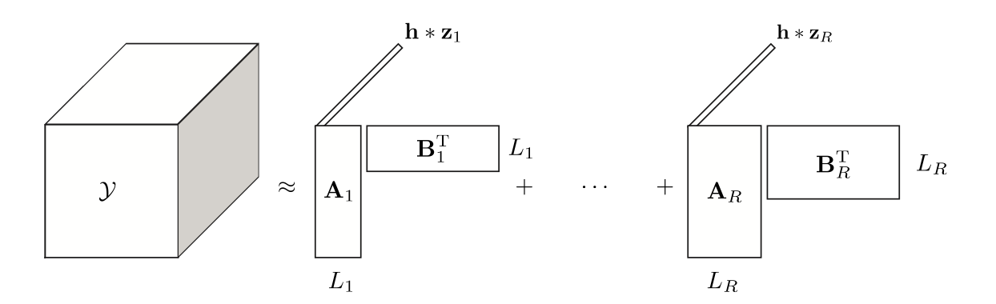
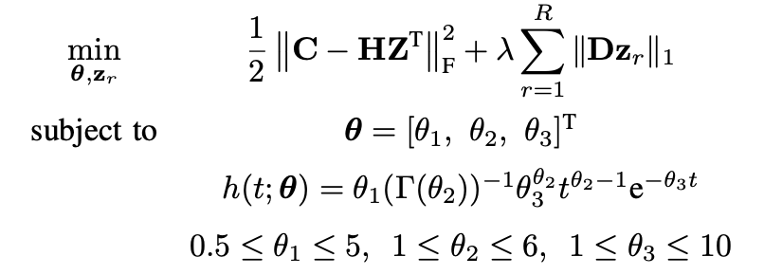
Towards whole-brain deconvolution
time
Step 1.
Step 2.
Kotti & Hunyadi. (2024) EUSIPCO
Notes:
Currently, we are working on a model to solve these issues. We consider low-rank spatial maps – like in the work of Chatzichristos, the realistic HRF model based on the gamma model I have shown before. Ideally, we want to have data-driven parcels.

Slide 18
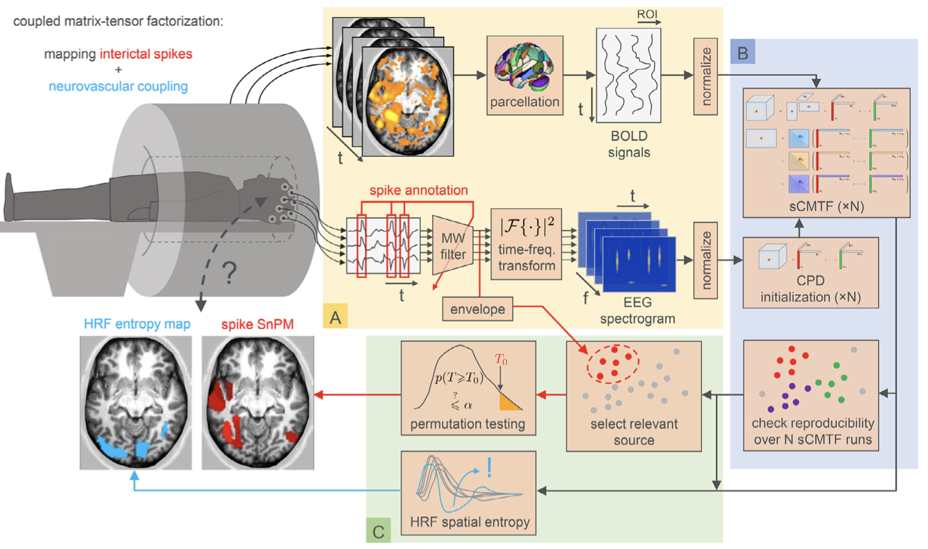
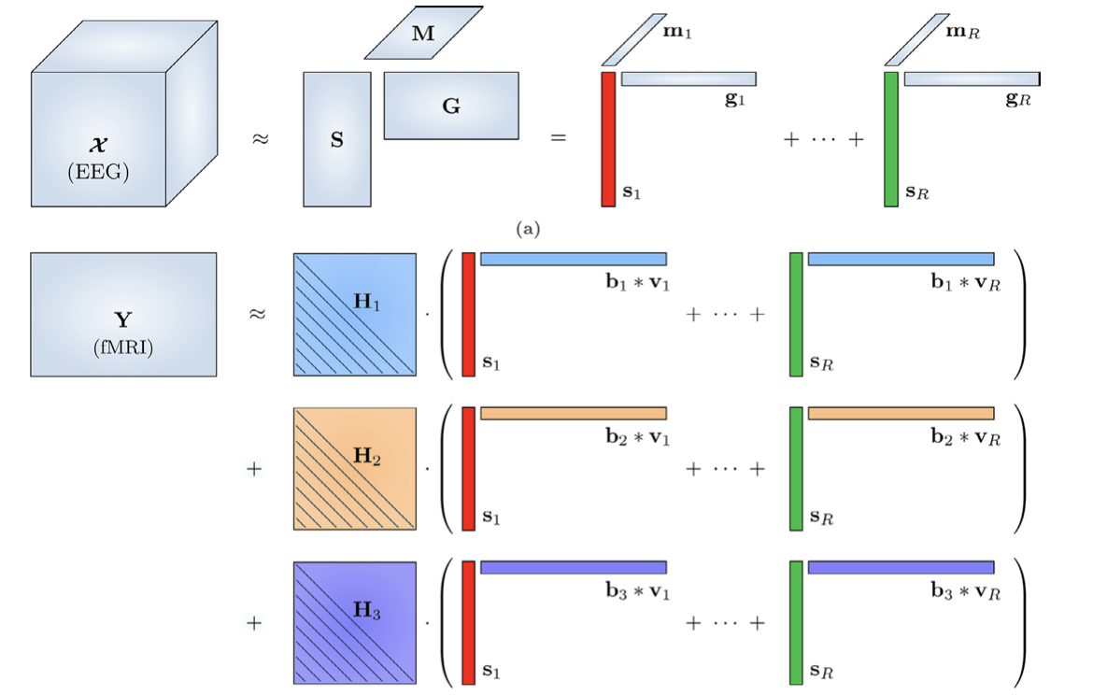
Flexible coupled decomposition of EEG-fMRI
EEG-fMRI in presurgical evaluation of epilepsy: combine the strength of both modalities
Temporal coupling:
HRF model accounts for biophysical mismatch
Realistic, flexible HRF per parcel
LIMITATION
Lost per-voxel resolution
Predefined parcels in epilepsy?
Van Eyndhoven et al (2021), Neuroimage
Notes:
Let us turn back to the original clinical problem: the epilepsy use-case. Our goal with EEG-fMRI is to combine the strengths of both modalities. One of the main motivations for estimating realistic, region-specific hemodynamic responses is that it enables a much tighter integration of EEG and fMRI.
On the EEG side, we aim to extract the short, transient epileptic spikes.
On the fMRI side, we want to recover the spatial signature of those same events together with their voxel-wise localization.
The key point is that these two modalities are observing the same underlying neural activity. So, we will jointly decompose them using a coupled matrix-tensor factorization, with the temporal signatures coupled.
However, these temporal signatures are not identical.
The fMRI signal is a delayed and blurred version of the EEG activity because it is transformed by the hemodynamic response.
We explicitly model this transformation by premultiplying the sources with the parametrized HRF. Notice that we have 3 copies of each source, with 3 different HRF, the only difference is a weight b across the 3 copies. This allows us to have a parcel-specific HRF that is the linear combination of 3 HRF basis functions.
The result is a flexible coupled tensor decomposition that jointly estimates the neural activity, the spatial maps, and the hemodynamic response while respecting the physics of both measurement modalities.

Slide 19
The signal processing challenge
Large observations
Mixture of sources
✅
✅
EEG: 100 x 10⁷ (24 hrs)
fMRI: 10⁵ x 1000 (20 min)
Activity of interest
Background brain activity
Physiological artifact
Noise
Different biophysics
Low SNR
✅
⚠️
Due to mixing
Activity is sparse in time
and space
Mismatch in references space and resolution
Different temporal dynamics
Indirect measurement
Notes:
So, where are we?
We have shown you how incorporating the hemodynamic response into the model allows us to address the mismatch in dynamics between EEG and fMRI.
But none of these solutions is perfect and there are still many open issues.
Why is this problem still so difficult?
The answer lies in the signal itself.

Slide 20
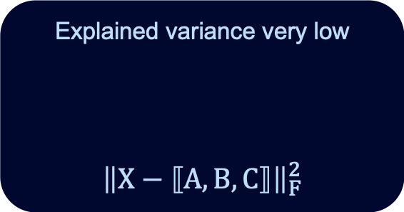
Needle in a haystack
25% of patients have less than 20 spikes within 20 minutes
signal of interest spans 1% of the whole signal in time
Explained variance very low
$${\left\|X−⟦A,B,C⟧\right\|}_{F}^{2}$$
Notes:
The problem is that the signal of interest is extremely sparse.
In many patients, only a handful of epileptic spikes occur during an entire fMRI acquisition.
So although these spikes are clinically very important, they account for only a tiny fraction of the recording—and therefore only a tiny fraction of its total variance.
From a signal processing perspective, this creates a fundamental difficulty.
Tensor decompositions are designed to explain as much of the observed data as possible.
Consequently, they first extract components that account for the largest proportion of the variance.
The epileptic component may therefore appear only much later in the decomposition, after many unrelated components have already been extracted.
In other words, we are searching for a needle in a haystack.
So the question becomes:
How can we guide the decomposition toward the component that we actually care about?

Slide 21
Solution Strategy
Representation that is exclusive to the signal of interest
Appropriate constraints
Correct number of components
Notes:
There are essentially three ways to address this low-SNR problem.
The first is to choose a representation that emphasizes the signal of interest while suppressing everything else.
For example, epileptic spikes become sparse—and therefore low-rank—in a wavelet representation.
In contrast, physiological artifacts are typically broadband or temporally diffuse.
They cannot be represented by a single low-rank component, so their variance is naturally distributed across many smaller components instead of competing with the epileptic activity.
The second strategy is to incorporate prior knowledge through appropriate constraints.
We have already seen an example of this.
Instead of allowing arbitrary temporal filters, we constrained the hemodynamic response to follow a physiologically meaningful parameterization.
By restricting the solution space to realistic HRFs, the decomposition is much more likely to recover the component we are actually interested in.
Finally, we need to determine the correct number of components.
And that is the third challenge I would like to discuss

Slide 22
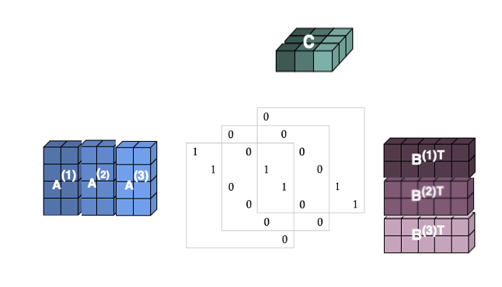
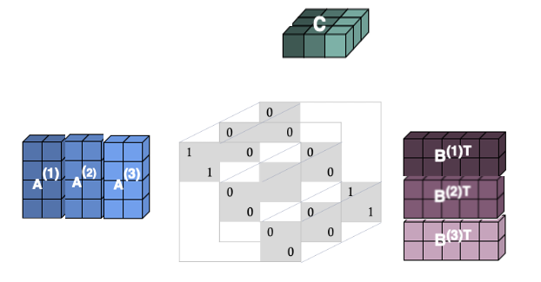
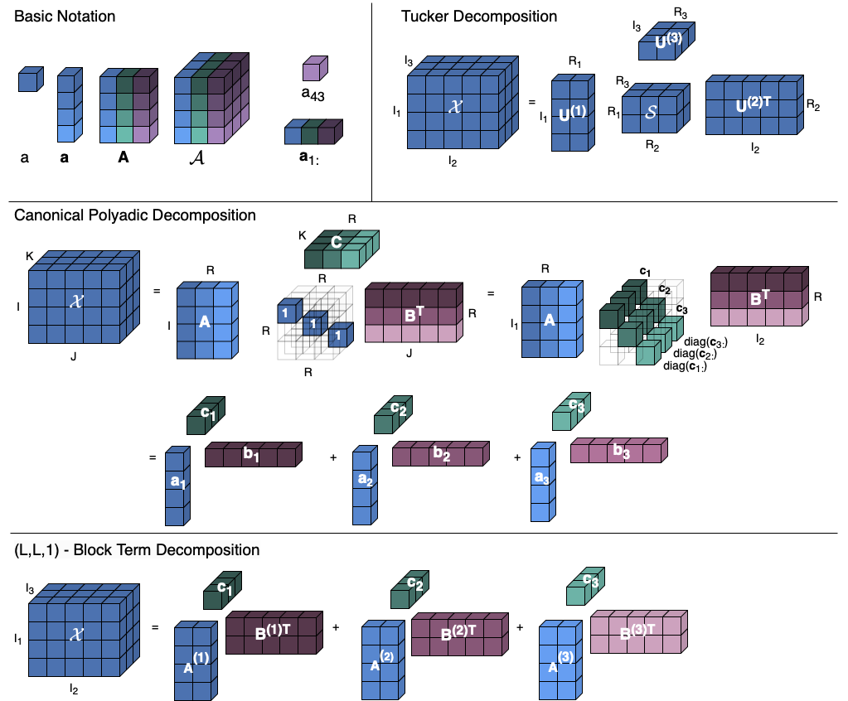

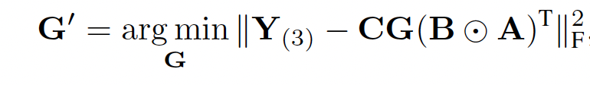
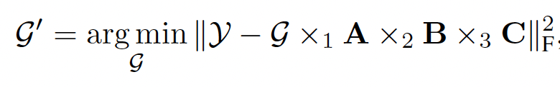
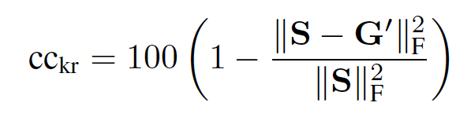
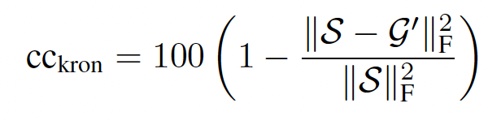
Selecting an appropriate rank
CORE CONSISTENCY DIAGNOSTIC for CPD:
CORE CONSISTENCY DIAGNOSTIC for BTD:
In an appropriate (L_{r},L_{r},1)-BTD, there are interactions among A^{(r)}, B^{(r)} and c_{r} only
In an appropriate CPD, there are interactions among a_{r}, b_{r} and c_{r} only
X
X
Same metric as CPD, but the ideal S is specific to the choice of L_{r}
cc_{CPD}
cc_{kron}
Kotti & Hunyadi. (2026) submitted
Notes:
Link to preprint:
http://sps.ewi.tudelft.nl/pubs/kotti2026_corcondia.pdf
The final ingredient is choosing the correct number of components.
For CPD, one of the most successful approaches is the core consistency diagnostic.
The idea is remarkably simple.
If the data truly follow a trilinear CPD model, the ideal Tucker core is superdiagonal.
So, after estimating the factor matrices, we fit a Tucker core while keeping those factors fixed.
If the fitted core closely resembles the ideal superdiagonal core, we conclude that the chosen rank is appropriate.
This similarity is quantified by the core consistency, with values close to one indicating an excellent model.
Can we apply the same idea to Block Term Decomposition?
The answer is yes—but the ideal core is no longer superdiagonal.
Instead, each component occupies its own block along the block diagonal.
So after fitting the core, we compare it with this ideal block-diagonal structure, giving a first extension of core consistency to BTD.
There is, however, another way to look at the problem.
BTD can also be written in its compact form, where the low-rank factors are already combined through the Khatri-Rao product.
In this representation, the desired interactions between the spatial factors are already enforced.
The only remaining question is whether unwanted interactions appear with the third mode.
This naturally leads to a second consistency measure that focuses specifically on this false cross-talk.

Slide 23
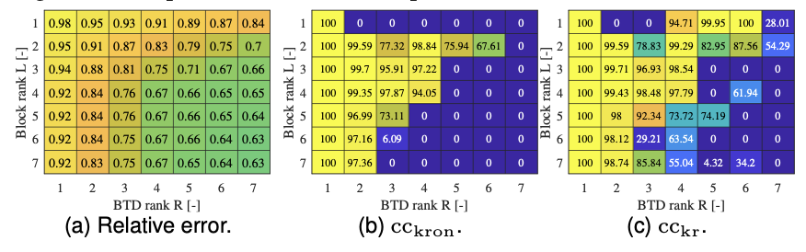
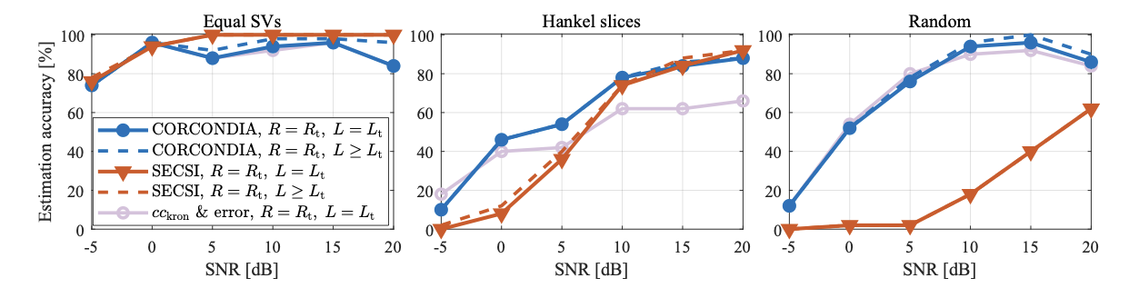
Core consistency: the pros and cons
Retrospective:
need to run decomposition
in grid-search
Not fully automated
All-at once algorithms:
SECSI
Kotti & Hunyadi. (2026) submitted | Khamidullina et al (2023), IEEE TSP
Notes:
So how do these diagnostics perform?
Here I first show a representative example.
The tensor was generated with four block terms, each having block rank four. As expected, both consistency measures remain high while the correct model is used.
As soon as the true rank is exceeded, they drop sharply, providing a clear indication of overestimating the model complexity.
I need to make two notes: the metric is a retrospective one: BTD models of various rank and block-rank values need to be computed and evaluated using the metric. The technique is not automated either, the user needs to use their judgement on what is a sufficient fit value and what drop in metric value is inacceptable. In this sense, it cannot compete with all-at once algorithms which estimate the rank and compute the decomposition at the same time. Rather, these approaches are complementary to each other.
Let’s see what happens when we evaluate both diagnostics and an all-at once algorithm on fifty simulated datasets with known ground-truth ranks and counted how many times we could select the correct rank using the metric.
For random tensors with equally strong components, the current state-of-the-art method performs exceptionally well; similarly to our metric; but with much less computations.
The picture changes when the problem becomes more realistic. Especially at low SNR regimes, it is quite hard to estimate the correct rank.
When the components have unequal strengths—so some components are much weaker than others—our approach becomes more reliable.
The same is true for tensors with Hankel-structured slices. Here, for high-SNR setting, our metric and the state-of-the art are comparable.
Notice that in this case our second, khatri-rao based metric complements the more general metric. Without the second metric, the correct rank is found less often.
In summary, in difficult problems our metric is more reliable than SOTA algorithms. But of course, this improved performance comes at a price.
Nevertheless, when reliable model selection is critical, we believe this additional computational cost is a worthwhile trade-off.

Slide 24
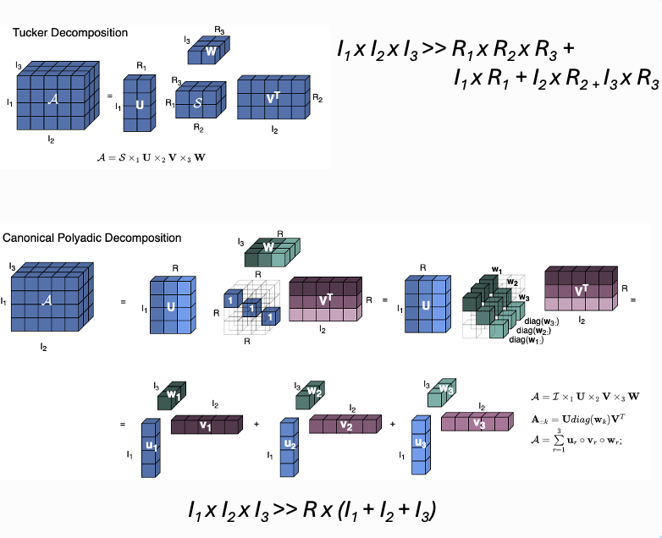
Where are we?
Estimate ranks ✅
Estimate HRFs ✅
Estimate neural time courses ✅
Estimate spatial maps ✅
Epilepsy is a network disorder!
Notes:
So, where are we now?
We started from the observation that both EEG and fMRI measure mixtures of many underlying neural sources.
Using tensor decompositions, we can separate those mixtures into their latent components.
We have seen how to estimate the number of components, how to model the hemodynamic response, and ultimately how to recover the underlying neural activity together with its spatial organization.
This already tells us something very important.
If we identify the correct source, we gain valuable information about where the pathology is located.
But that is only part of the story.
To fully understand the pathology—and ultimately to guide treatment—we also need to understand how that region interacts with the rest of the brain.
In other words, we need to identify the network to which the pathological region belongs.
So the next question becomes:
How can we move from localized sources to brain networks?

Slide 25
The signal processing challenge
Large observations
Mixture of sources
✅
✅
EEG: 100 x 10⁷ (24 hrs)
fMRI: 10⁵ x 1000 (20 min)
Activity of interest
Background brain activity
Physiological artifact
Noise
How to derive network structure from data?
Different biophysics
Low SNR
✅
✅
Mismatch in references space and resolution
Different temporal dynamics
Indirect measurement
Due to mixing
Activity is sparse in time
and space
Notes:
From a signal processing perspective: on top of all existing challenges, how to derive network structure from the data?

Slide 26
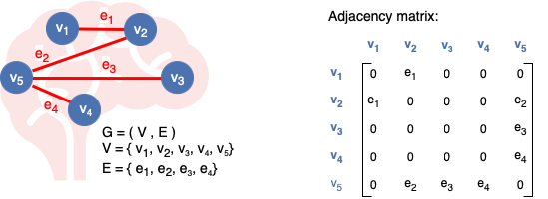
Brain networks and Graphs
Notes:
This is the object we're interested in.
The nodes represent brain regions, and the edges represent the functional connectivity between them.
The challenge is that such networks and the corresponding matrices can become extremely large and complex.

Slide 27
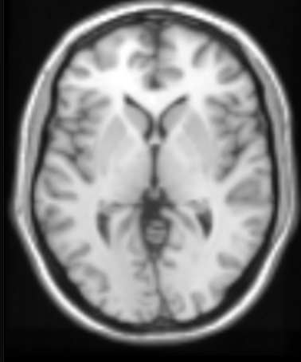
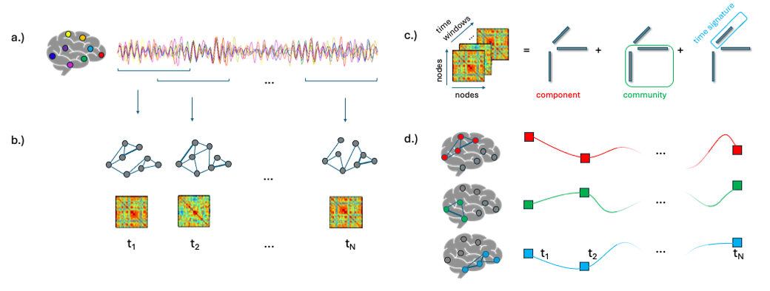
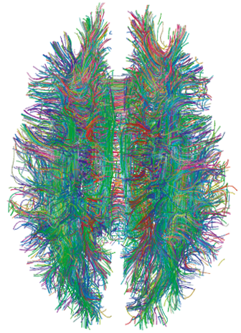
Network communities
regions of interest
community detection
10⁵ voxels
10¹⁰ connections
116 ROIs
13456 connections
communities
Definition: subsets of densely connected nodes within the network
Aim: derive a handful of meaningful communities from big and complex brain data
How to do? Non-negative matrix factorization (note: there are many other ways…)
Notes:
A typical fMRI dataset contains on the order of 100,000 voxels.
The corresponding connectivity matrix would contain billions of connections—far too large to fit into memory, let alone interpret directly.
Grouping voxels into a smaller number of regions of interest helps alleviate the computational burden, but interpreting such a large connectivity matrix remains a challenge.
So rather than studying individual connections, I'm interested in identifying communities: groups of brain regions that are more strongly connected to one another than to the rest of the brain.
This provides a much more compact and interpretable description of the network.
My goal, therefore, is to derive a small number of meaningful communities from this large and complex network.
There are many ways to do this. Today I'll focus on a tensor formulation based on non-negative matrix factorization.

Slide 28
Brain and dynamic community detection
OBSERVATIONS
MODEL
observed graphs are linear combinations of underlying communities with varying activity levels over time
How to retrieve the communities and their time courses?
Notes:
But of course, the brain is constantly changing.
Different communities become active at different moments in time.
So rather than looking for a single network, we now want to identify a set of latent communities together with their changing activity over time.
I make an assumption that should sound familiar.
Just as in blind source separation, I assume that the observed connectivity patterns are linear combinations of a small number of underlying communities, each with a time-varying activity level.
The question then becomes:
How can we recover those communities from the observed data?

Slide 29
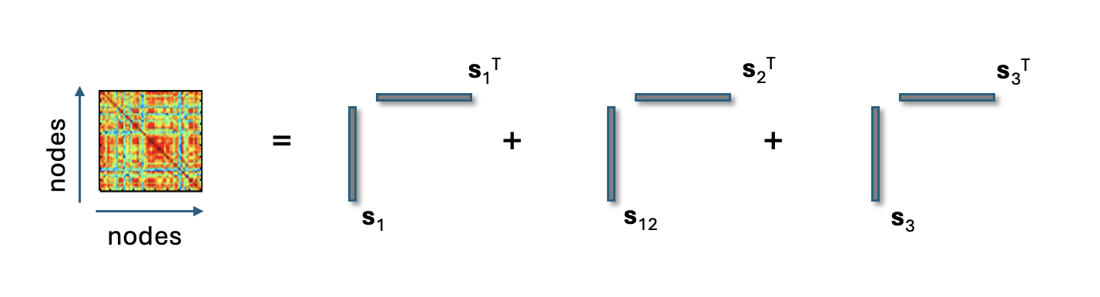

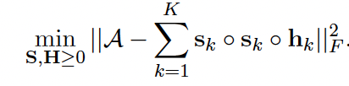
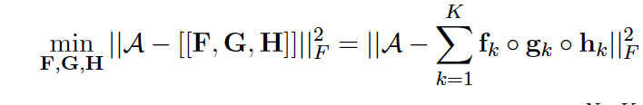
From NMF to CPD
A
h₁
h₂
h₃
s₁^{T}
s₂^{T}
s₃^{T}
unconstrained version could work (CPD unique)?
s₁
s₂
s₃
s_{k}: community membership vector
for community k
h_{k}: temporal signature for community k
Notes:
Let's first consider a single connectivity matrix.
A standard and widely used approach for community detection is symmetric non-negative matrix factorization.
The idea is that each brain region has a non-negative membership in one or more communities, and the connectivity between two regions is explained by their shared community memberships.
Now we return to the dynamic setting.
Instead of a single connectivity matrix, we have one for every time window.
Stacking these matrices over time naturally gives rise to a third-order tensor.
The community structure is shared across time, while the expression of each community is allowed to vary from one time window to the next.
This naturally extends the symmetric NMF model to a Canonical Polyadic Decomposition.
So once again, we arrive at a tensor decomposition problem.

Slide 30
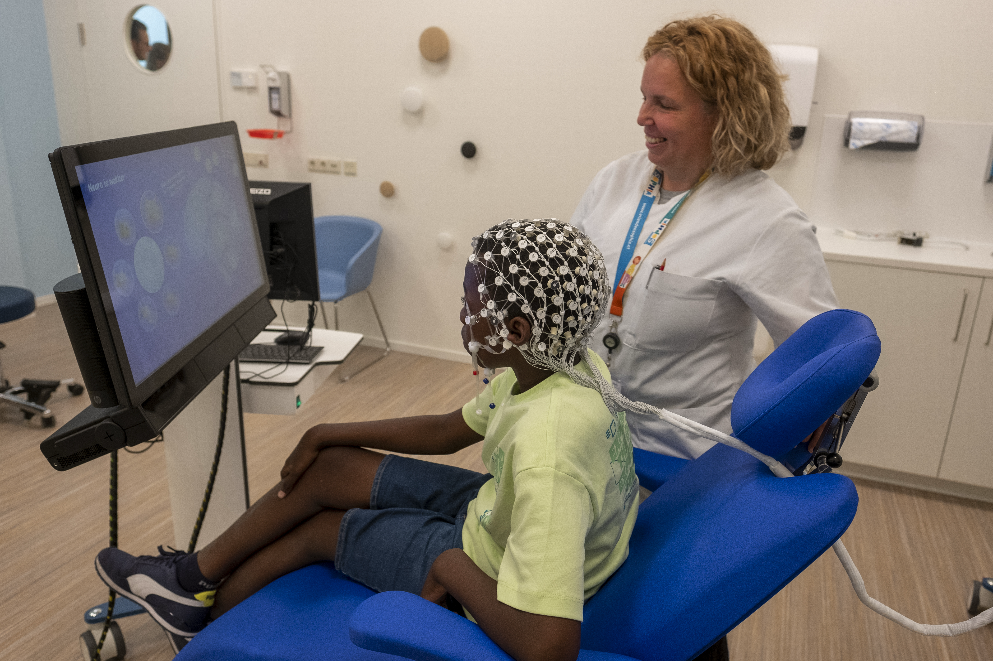
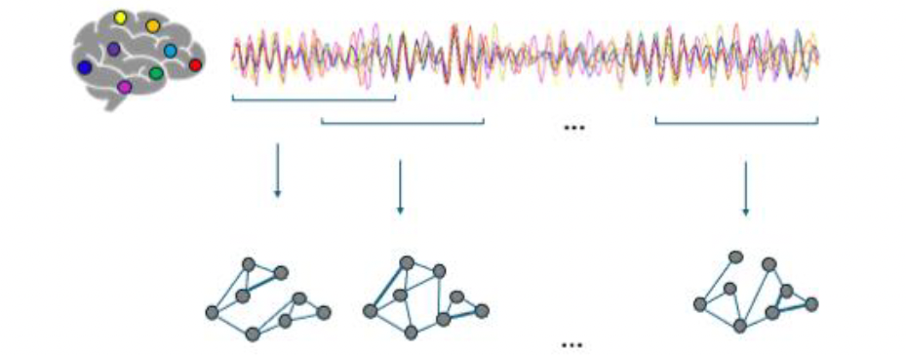



NeuroMark: Network signatures as biomarkers
Child Brain Lab @
Erasmus MC, Rotterdam
Follow-up
Subject signature
Subjects
Temporal signature
Notes:
“This brings me to my main project, NeuroMark, a collaboration with the Child Brain Lab at Erasmus MC.
So far, we've discussed how tensor decompositions help us recover latent neural activity. But they are much more flexible than that.
The same framework can also be used to study brain networks.
In NeuroMark, we analyze EEG recordings from children with a broad range of neurodevelopmental disorders, with the aim of discovering network biomarkers.
Let's first consider network dynamics.
Suppose we estimate a functional connectivity matrix at successive time points. If we stack these matrices along a third mode, we obtain a connectivity tensor.
After tensor decomposition, the factors in this third mode tell us how each network community evolves over time.
This immediately opens interesting possibilities. We can relate the temporal signatures to events in the EEG, or, in longitudinal studies, investigate how functional brain networks evolve as the brain matures over months or years.
But time is not the only source of variation.
Instead of stacking connectivity matrices across time, we can stack them across subjects.
Now the third-mode factors no longer describe temporal evolution. Instead, they capture how strongly each network community is expressed in each subject.
This allows us to compare healthy and diseased brains and identify network structures that are characteristic of a particular disorder.
These subject signatures can therefore serve as candidate network biomarkers, which is precisely the goal of NeuroMark.

Slide 31

Limitations of CPD
Reveals community membership
No structure within the community
rank-1
Why would the connections of any node i proportional to node j ?
what we have:
what we want:
Notes:
So far, the results look promising.
However, there is one important limitation of CPD.
Each community is represented by a membership vector. The corresponding connectivity matrix is obtained by taking its outer product with itself.
This gives a connectivity matrix of the correct size, but it is always rank one.
That is a very restrictive assumption. Real brain communities are unlikely to have such a simple connectivity structure.
Instead, we would like each community to be represented by a low-rank connectivity matrix.
This is exactly what Block Term Decomposition provides.
In the previous slide, I showed that tensor decompositions provide a flexible framework for studying brain networks.
The next question is: which decomposition should we use?
Let's first consider CPD.
Each community is described by a membership vector. The corresponding connectivity matrix is obtained by taking the outer product of this vector with itself.
This gives a connectivity matrix of the correct dimensions, but it is always rank one.
That is quite a restrictive assumption for real brain networks.

Slide 32

From CPD to (L_{r},L_{r},1)-BTD
CPD:
BTD:
rank-2
More
realistic
Gujral et al (2020) | Hunyadi & Aviyente (2025) IEEE SPM
Notes:
Instead, we would like each community to be represented by a low-rank connectivity matrix.
This naturally leads us from CPD to Block Term Decomposition.
"The only difference is that we replace the rank-one outer product with a low-rank matrix factorization. Each community is now described by a low-rank connectivity pattern rather than a single outer product. This gives the model considerably more flexibility while retaining the interpretability of the temporal signatures."

Slide 33

Dynamic network communities during task
64 x 64 x 96
PLV across 64 channels
96 overlapping windows
Average across subjects
CPD
BTD
Hunyadi & Aviyente (2025) IEEE SPM
Notes:
Let's see how this works in practice.
Here, the subjects perform a cognitive task. Whenever they make an error, a characteristic negative EEG deflection appears over the central electrodes. This is known as the error-related negativity, or ERN.
I use this dataset as a benchmark to compare unconstrained CPD and BTD.
The first observation is that both decompositions recover the same temporal phenomenon. In fact, the temporal signatures are so similar that I only show the connectivity patterns here.
However, CPD requires considerably more components. It appears that BTD groups several CPD components into a single, richer representation, so in practice only two or three components are sufficient.
More importantly, notice the difference in the spatial patterns.
CPD tells us which electrodes belong to a community, but it does not reveal how they are connected.
BTD, on the other hand, directly estimates the connectivity strengths within each community.
For example, in component three, we see strong local connectivity within neighbouring electrode clusters, together with weaker long-range connections between those clusters. This is a much more realistic representation of a functional brain network.

Slide 34





Group differences in dynamic network communities
200ms windows
Concatenate subjects
…
Participant 1 …. Participant 81
BTD
Community
structure 1
Community
structure 2
Köves & Hunyadi (2026), EUSIPCO
Notes:
Having shown that BTD can recover meaningful network communities, the next question is whether these communities are also clinically informative.
To investigate this, we analyzed a dataset containing schizophrenia patients and healthy controls.
The analysis is almost identical to the previous example. We first estimate dynamic connectivity, concatenate the connectivity tensors from all participants, and apply exactly the same tensor decomposition.
The only difference is in how we interpret the third-mode signatures.
Instead of describing temporal evolution within a single subject, we now organize these signatures by participant and compare them across the two groups.

Slide 35

Networks dynamics differ in Schizophrenia
Köves & Hunyadi (2026), EUSIPCO
Notes:
The results reveal two communities with significant group differences.
The first community involves widespread connectivity across almost all electrodes. Following stimulus presentation, this overall connectivity is significantly stronger in the healthy controls than in the schizophrenia patients.
The second community consists of a frontal and a posterior cluster. Here, the connectivity between these two regions is reduced, and this disconnection is significantly stronger in the schizophrenia group.
So, without changing the decomposition itself, we can move from identifying dynamic brain networks to identifying network biomarkers of disease.

Slide 36
The signal processing challenge
Large observations
Mixture of sources
✅
✅
✅
EEG: 100 x 10⁷ (24 hrs)
fMRI: 10⁵ x 1000 (20 min)
Activity of interest
Background brain activity
Physiological artifact
Noise
Derive networks
✅
Different biophysics
Low SNR
✅
✅
Mismatch in references space and resolution
Different temporal dynamics
Indirect measurement
Due to mixing
Activity is sparse in time
and space
Notes:
Let's return to the challenges we started with.
"So far, we've seen how tensor models help us tackle the large-scale nature of the data, separate latent activity, account for the different biophysics of EEG and fMRI, estimate neural time courses and spatial maps, and finally, derive functional brain networks.”
"In other words, we can now recover not only where activity occurs, but also how different brain regions interact.”

Slide 37
Open challenges
SCALING UP
Whole-brain connectivity and deconvolution
REAL DATA
Notoriously noisy
Realistic benchmark
datasets
TRANSLATION
User-friendly tools
for non-technical users
Notes:
Let me conclude with a few challenges as a sort of call for action.
The first is scalability.
Our imaging datasets are getting increasingly sophisticated and detailed. Therefore, Whole-brain identification of HRF or network connectivity quickly becom computationally prohibitive, so we need algorithms that scale to these data.
The second challenge is real-world data.
Much of our methodological development is still driven by clean simulations or relatively well-behaved datasets.
But clinical neuroimaging is very different.
The signal of interest is weak, while the interference is often high-amplitude, highly structured, and far from Gaussian.
I therefore believe we should develop and benchmark our algorithms with these challenging conditions in mind.
Finally, there is the challenge of translation.
Tensor decompositions are incredibly flexible, but that flexibility comes at the cost of expertise. Today, applying these methods still requires substantial knowledge of both optimization and the application domain.
If we want these methods to make a real clinical impact, we need user-friendly tools that clinicians and neuroscientists can actually use.
In summary, I hope I have convinced you today that tensor decompositions are much more than elegant mathematical models. They provide a flexible framework for addressing a wide range of signal processing challenges, taking us from multichannel signals all the way to clinically meaningful brain networks.
Thank you for your attention.

Slide 38


Thank you!
KU Leuven
Simon Van Eyndhoven
TU Delft
Aybuke Erol
Sofia Kotti
Pieter Kruizinga
Maastricht University
Simon Tousseyn
Clinical collaborators
Wim Van Paesschen
Robert van den Berg
External collaborators
Selin Aviyente
Aron Boldizsar Koves

Slide 39
References (1/2)
Slide 3 Dallmer-Zerbe, I., Jiruska, P., & Hlinka, J. (2023). Personalized dynamic network models of the human brain as a future tool for planning and optimizing epilepsy therapy. Epilepsia, 64(9), 2221–2238. https://doi.org/10.1111/epi.17690
Slide 4 Gula, J., Hunyadi, B., Schijns, O. E., Jansen, J. F. A., Tousseyn, S., Backes, W. H., ... & Widman, G. (2026). Electrophysiology–MRI integration for epileptogenic zone detection and surgical prediction–A narrative review. Clinical Neurophysiology, 2112333. https://doi.org/10.1016/j.clinph.2026.2112333
Slide 6 Hunyadi, B., Dupont, P., Van Paesschen, W., & Van Huffel, S. (2017). Tensor decompositions and data fusion in epileptic electroencephalography and functional magnetic resonance imaging data. Wiley Interdisciplinary Reviews: Data Mining and Knowledge Discovery, 7(1), e1197, https://doi.org/10.1002/widm.1197
Slide 9 Jung, T. P., Makeig, S., Humphries, C., Lee, T. W., Mckeown, M. J., Iragui, V., & Sejnowski, T. J. (2000). Removing electroencephalographic artifacts by blind source separation. Psychophysiology, 37(2), 163-178. https://doi.org/10.1111/1469-8986.3720163
Slide 9 Calhoun, V. D., Liu, J., & Adalı, T. (2009). A review of group ICA for fMRI data and ICA for joint inference of imaging, genetic, and ERP data. NeuroImage, 45(1, Suppl. 1), S163–S172. https://doi.org/10.1016/j.neuroimage.2008.10.057
Slide 10 Hunyadi, B., Tousseyn, S., Mijović, B., Dupont, P., Van Huffel, S., Van Paesschen, W., & De Vos, M. (2013). ICA extracts epileptic sources from fMRI in EEG-negative patients: A retrospective validation study. PLoS ONE, 8(11), e78796. https://doi.org/10.1371/journal.pone.0078796
Slide 10 Hunyadi, B., Tousseyn, S., Dupont, P., Van Huffel, S., De Vos, M., & Van Paesschen, W. (2015). A prospective fMRI-based technique for localising the epileptogenic zone in presurgical evaluation of epilepsy. NeuroImage, 113, 329–339. https://doi.org/10.1016/j.neuroimage.2015.03.011
Slide 11 Chatzichristos, C., Kofidis, E., Morante, M., & Theodoridis, S. (2019). Blind fMRI source unmixing via higher-order tensor decompositions. Journal of Neuroscience Methods, 315, 17–47. 10.1016/j.jneumeth.2018.12.007
Slide 13 Handwerker, D. A., Ollinger, J. M., & D’Esposito, M. (2004). Variation of BOLD hemodynamic responses across subjects and brain regions and their effects on statistical analyses. NeuroImage, 21(4), 1639–1651. https://doi.org/10.1016/j.neuroimage.2003.11.029
Slide 13 Siero, J. C. W., Petridou, N., Hoogduin, H., Luijten, P. R., & Ramsey, N. F. (2011). Cortical depth-dependent temporal dynamics of the BOLD response in the human brain. Journal of Cerebral Blood Flow & Metabolism, 31(10), 1999–2008. https://doi.org/10.1038/jcbfm.2011.57
Slide 13 Rangaprakash, D., Wu, G.-R., Marinazzo, D., Hu, X., & Deshpande, G. (2018). Hemodynamic response function (HRF) variability confounds resting-state fMRI functional connectivity. Magnetic Resonance in Medicine, 80(4), 1697–1713. https://doi.org/10.1002/mrm.27146

Slide 40
References (2/2)
Slide 15 Van Eeghem, F., & De Lathauwer, L. (2017, March). Second-order tensor-based convolutive ICA: Deconvolution versus tensorization. In 2017 IEEE International Conference on Acoustics, Speech and Signal Processing (ICASSP) (pp. 2252-2256). IEEE. 10.1109/ICASSP.2017.7952557
Slide 15 Erol, A., Soloukey, C., Generowicz, B., Van Dorp, N., Koekkoek, S., Kruizinga, P., & Hunyadi, B. (2023). Deconvolution of the functional ultrasound response in the mouse visual pathway using block-term decomposition. Neuroinformatics, 21(2), 247-265. https://doi.org/10.1007/s12021-022-09613-3
Slide 16 Cherkaoui, H., Moreau, T., Halimi, A., Leroy, C., & Ciuciu, P. (2021). Multivariate semi-blind deconvolution of fMRI time series. NeuroImage, 241, 118418. https://doi.org/10.1016/j.neuroimage.2021.118418
Slides 17 Kotti, S.-E., & Hunyadi, B. (2024). Extracting hemodynamic activity with low-rank spatial signatures in functional ultrasound using tensor decompositions. Proceedings of EUSIPCO 2024, Lyon, France
Slide 18 Van Eyndhoven, S., Dupont, P., Tousseyn, S., Vervliet, N., Van Paesschen, W., Van Huffel, S., & Hunyadi, B. (2021). Augmenting interictal mapping with neurovascular coupling biomarkers by structured factorization of epileptic EEG and fMRI data. NeuroImage, 228, 117652. https://doi.org/10.1016/j.neuroimage.2020.117652
Slide 22- 23 — Kotti SE, Hunyadi B. Core consistency diagnostic for the tensor block term decomposition. TechRxiv. 2025. Current version is hosted at https://sps.ewi.tudelft.nl/pubs/kotti2026_corcondia.pdf, but further updates will be uploaded to TechRxiv.
Slide 23 Khamidullina, L., Seidl, G., Podkurkov, I. A., Korobkov, A. A., & Haardt, M. (2023). Enhanced Solutions for the Block-Term Decomposition in Rank-$(L_ {r}, L_ {r}, 1) $ Terms. IEEE Transactions on Signal Processing, 71, 2608-2621. https://doi.org/10.1109/TSP.2023.3289730
Slide 29, 33 Hunyadi, B., & Aviyente, S. (2025). Brain Connectivity: From network science to tensor models. IEEE Signal Processing Magazine, 42(4), 8-24, https://doi.org/10.1109/MSP.2025.3600011
Slide 32 Gujral, E., Pasricha, R., & Papalexakis, E. E. (2020). Beyond rank-1: Discovering rich community structure in multi-aspect graphs. Proceedings of The Web Conference 2020, 452–462. https://doi.org/10.1145/3366423.3380129
Slide 34, 35 Köves, A. B., Hunyadi, B. Tensor-Based Analysis of Temporal Brain Networks for Schizophrenia Classification (2026) Accepted for publication at the 34th European Signal Processing Conference (EUSIPCO 2026)

Slide 41
Image sources (own work)
Slide 5 — Hunyadi, B., Dupont, P., Van Paesschen, W., & Van Huffel, S. (2017). Tensor decompositions and data fusion in epileptic electroencephalography and functional magnetic resonance imaging data. Wiley Interdisciplinary Reviews: Data Mining and Knowledge Discovery, 7(1), e1197.
Slide 6, 26, 33 — Hunyadi, B., & Aviyente, S. (2025). Brain Connectivity: From network science to tensor models. IEEE Signal Processing Magazine, 42(4), 8-24
Slide 10 — Hunyadi, B., Tousseyn, S., Mijović, B., Dupont, P., Van Huffel, S., Van Paesschen, W., & De Vos, M. (2013). ICA extracts epileptic sources from fMRI in EEG-negative patients: A retrospective validation study. PLoS ONE, 8(11), e78796.
Slide 15 — Erol, A., et al. (2023). Deconvolution of the functional ultrasound response in the mouse visual pathway using block-term decomposition. Neuroinformatics, 21, 247–265.
Slide 18 — Van Eyndhoven, S., Dupont, P., Tousseyn, S., Vervliet, N., Van Paesschen, W., Van Huffel, S., & Hunyadi, B. (2021). Augmenting interictal mapping with neurovascular coupling biomarkers by structured factorization of epileptic EEG and fMRI data. NeuroImage, 228, 117652
Slide 23 — Kotti SE, Hunyadi B. Core consistency diagnostic for the tensor block term decomposition. TechRxiv. 2025. Current version is hosted at https://sps.ewi.tudelft.nl/pubs/kotti2026_corcondia.pdf, but further updates will be uploaded to TechRxiv.
Slide 35 — Köves, A. B., Hunyadi, B. Tensor-Based Analysis of Temporal Brain Networks for Schizophrenia Classification (2026) Accepted for publication at the 34th European Signal Processing Conference (EUSIPCO 2026)

Slide 42
Image sources (external)
Slide 2 — Neurosurgery © Maastricht UMC+. Used with permission
Slide 3 Dallmer-Zerbe, I., Jiruska, P., & Hlinka, J. (2023). Personalized dynamic network models of the human brain as a future tool for planning and optimizing epilepsy therapy. Epilepsia, 64(9), 2221–2238. https://doi.org/10.1111/epi.17690, CC BY-NC 4.0
Slide 4 — Video-EEG: Jemaleddin Cole. EEG record of brain activity and wave patterns from a sleeping boy. Flickr (CC BY-SA 2.0), via Wikimedia Commons;Structural MRI: Ptrump16. MRI Scan General Illustration. Wikimedia Commons, CC BY-SA 4.0.; EEG-fMRI: Jan Ainali. Philips MRI in Sahlgrenska University Hospital, Gothenburg, Sweden. Wikimedia Commons, CC BY 3.0 and Chris Hope. EEG Recording Cap. Wikimedia Commons, CC BY 2.0.; PET: Nevit Dilmen. PET-CT in Management of Patients. Adapted (cropped) from Wikimedia Commons, CC BY-SA 3.0; SPECT: Adapted (cropped) from Foiadelli T, Lagae L, Goffin K, et al. Subtraction Ictal SPECT coregistered to MRI (SISCOM) as a guide in localizing childhood epilepsy. Epilepsia Open. 2020;5:61–72. CC BY 4.0; SEEG: Adapted (cropped) from Reinacher PC, Altenmüller D-M, Nakagawa JM, et al. Combined MRI morphometry and source imaging guide placement of stereo-EEG electrodes in focal epilepsy with subtle or absent lesions. Frontiers in Neurology. 2025;16:1685431. CC BY 4.
Slide 6 — Adapted (cropped) from M.M. Minderhoud (Michiel1972). Gebouw TU Delft. Wikimedia Commons, CC BY-SA 3.0.
Slide 9 — ICA of EEG: Adapted from Kong W, Zhou Z, Hu S, Zhang J, Babiloni F, Dai G. Automatic and Direct Identification of Blink Components from Scalp EEG. Sensors. 2013;13(8):10783–10801. CC BY 3.0.; ICA of fMRI: Adapted (cropped) from Schielen SJC, Pilmeyer J, Aldenkamp AP, Ruijters D, Zinger S. ICA-Based Resting-State Networks Obtained on Large Autism fMRI Dataset ABIDE. Data. 2025;10(7):109. CC BY 4.0
Slide 13 - Deshpande R, Wu G-R, Marinazzo D, Hu X, Deshpande G. Hemodynamic response function (HRF) variability confounds resting-state fMRI functional connectivity. Magn Reson Med. 2018;80(4):1697–1713. © Wiley. Reproduced with permission
Slide 16 Cherkaoui, H., Moreau, T., Halimi, A., Leroy, C., & Ciuciu, P. (2021). Multivariate semi-blind deconvolution of fMRI time series. NeuroImage, 241, 118418. CC BY-NC-ND 4.0
Slide 30 EEG recordings @ Child Brain Lab (CBL), Erasmus MC. Used with permission.
Slide 33 Seow TXF, Benoit E, Dempsey C, et al. A dimensional investigation of error-related negativity (ERN) and self-reported psychiatric symptoms. International Journal of Psychophysiology. 2020;158:340–348. CC BY 4.0
https://creativecommons.org/licenses/by-nc-nd/4.0/)

